Slide 1


1st Meeting - T3/2021
By,
D2i Geelong Squad

Slide 2



Project Overview
Aim
In 2015 Geelong City launched their Digital Geelong Strategy which aimed to guide the city efforts in becoming a clever and creative city region. ​
​
We will work with a representative from Geelong City Council to build and develop smart city initiatives, functioning as a melting pot for ideas and their rapid development.
International recognition of Geelong as ‘a clever and creative city-region that is forward looking, enterprising and adaptive, and cares for its people and environment’ by 2047.
Sub-team
1) Machine Learning
2) Data Visualization
3) Web Development

Slide 3


Meet the team
MACHINE LEARNING
DATA VISUALIZATION
WEB DEVLOPMENT
Sahit Mantripragada (Senior)
Rakshith Rachenahalli Bettegowda (Senior)
Rao Siddhant Yadav (Senior)
Kaiyuan Jiang (Senior)
Anugra Sara Thomas
Abdullah Abdulaziz M Algamdi
Saleh Mohammed M Alharbi
Rahul Kumar
Anyu Xu
Chris Chen

Slide 4

NAME
JR. / SR.
ROLE ASSIGNED
WORK DONE IN HOURS
BITBUCKET SETUP
ITERATION 1
ITERATION 2
RAO SIDDHANT YADAV
SENIOR
MACHINE LEARNING
46.2
RAKSHITH R BETTEGOWDA
SENIOR
WEB DEVELOPMENT
46.3
SAHIT MANTRIPRAGADA
SENIOR
DATA VISUALIZATION
44.3
KAIYUAN JIANG
SENIOR
MACHINE LEARNING
26
ABDULLAH A M ALGAMI
JUNIOR
WEB DEVELOPMENT
35.4
SALEH M M ALHARBI
JUNIOR
WEB DEVELOPMENT
34.2
ANUGRA SATA THOMAS
JUNIOR
MACHINE LEARNING
30.2
RAHUL KUMAR
JUNIOR
MACHINE LEARNING
36.5
ANYU XU
JUNIOR
DATA VISUALIZATION
27.1
CHRIS CHEN
JUNIOR
DATA VISUALIZATION
17

Slide 5



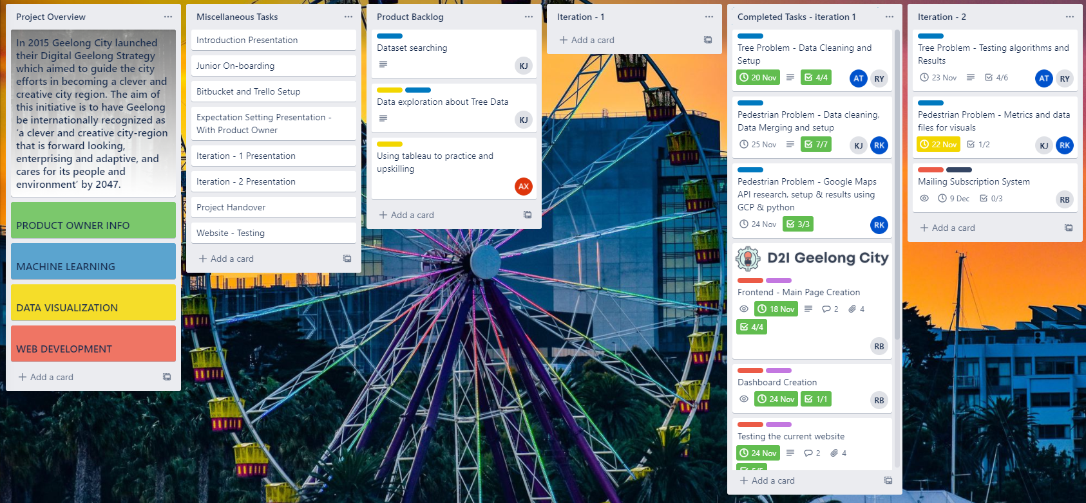

Slide 6
UML and Tech Stack
Home/Website
Trees Problem
Pedestrian Problem
Fire problem
Wifi Problem
Prediction
Visualization
Prediction
Visualization
All problem are integrated to the website by deploying live ML models. Exact mapping will be illustrated in the next itegration.

Slide 7
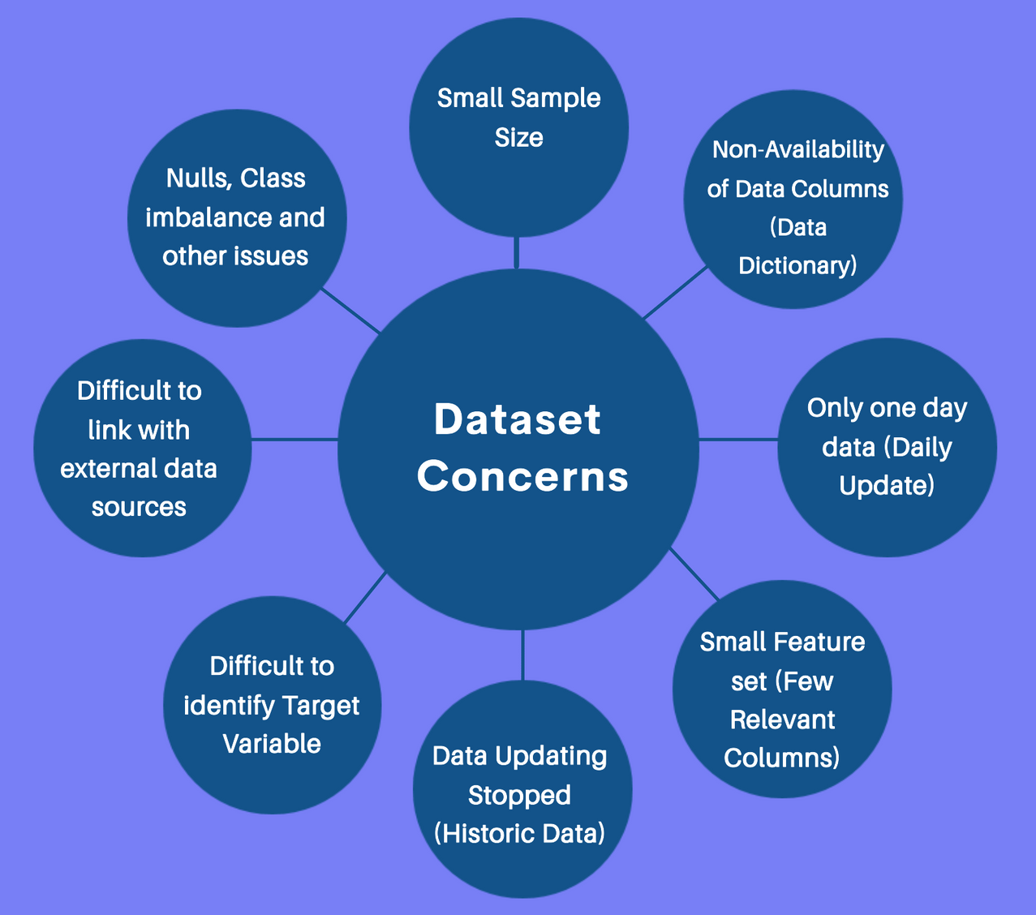
Dataset
Concerns

Slide 8

Fire Problem
Time series prediction
Wifi Problem
Tree Problem
Prediction classification and regression
Clustering and prediction
Housing Development Data 2013-19
MACHINE LEARNING
Road Segment
Drainage Pipes
Pedestrian
API and metrics
Solver and Capacity
Parking Utilization
Powercor Public Lights

Slide 9

Tree Problem
A two part exercise that incorporates visualization related to trees at a suburb and tree type level and other relevant metrics, with prediction of tree on the basis of its features in Greater city of Geelong
Pedestrian Problem
To keep a track of citizen in Geelong city and types of places they have been to. This keeps track of citizen movement in restaurants, hospitals etc in post lockdown time in the city. We use Google API to get this information and monitor movement.
Fire Problem
Bushfires are an inconsistent hazard in Geelong City but it does create havoc when it affect the city. With high risk fire regions as close as 80km from Geelong, it is important to predict the possibility of fire in each Geelong and nearby suburb. Use time series prediction algorithms like LSTM, GRU and boosting algorithms
Wi-Fi Problem
With variable foot count in and around important hubs in Geelong City where free Wi-Fi is provided, it is important to know the foot count of users to increase/decrease router bandwidth or count as per usage. We plan to incorporate time series prediction exercises and MLP techniques for this task and check performance.

Slide 10

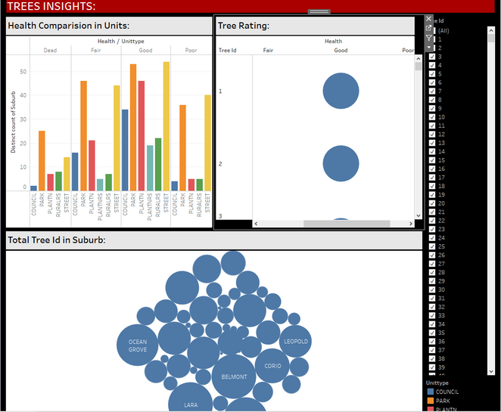
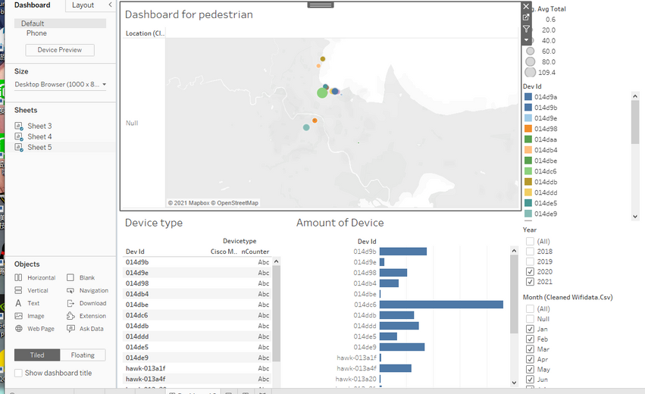

Data Visualization
1st goal: to work on Trees and Pedestrians Dashboards with showcasing key metrics in the dashboard.
2nd goal: Showcasing multiple charts in trees such as bar chart which shows distinct count of tree id to health / unit type, bubble chart which shows distinct count of total tree id to suburbs.
3rd goal: establish clear relationships between the metrics.
4th goal: Working on pedestrians’ problem.
5th goal: showcase various metrics on Geelong map, using date, year and time filters and functions.
6th goal: establish clear relationships between the metrics.
7th goal: Working on fire problem and wifi problem figuring out the best possible metrics and establish a meaningful dashboard.
8th goal: Working on publishing the work through tableu server and interacting with the web team to integrate the work.

Slide 11


Web development
Test and fix issues.
Enhance UI | Homepage and Inner pages
Frontend
Dashboards for tableau and live machine learning models
Create Form for subscription and contact us
Subscription setup with two-factor authentication
Integrate analysis from data visualization team
Backend
Deploy Machine learning models
Host the new website

Slide 12
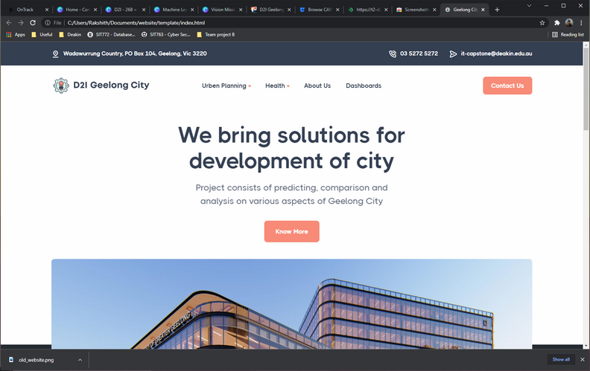
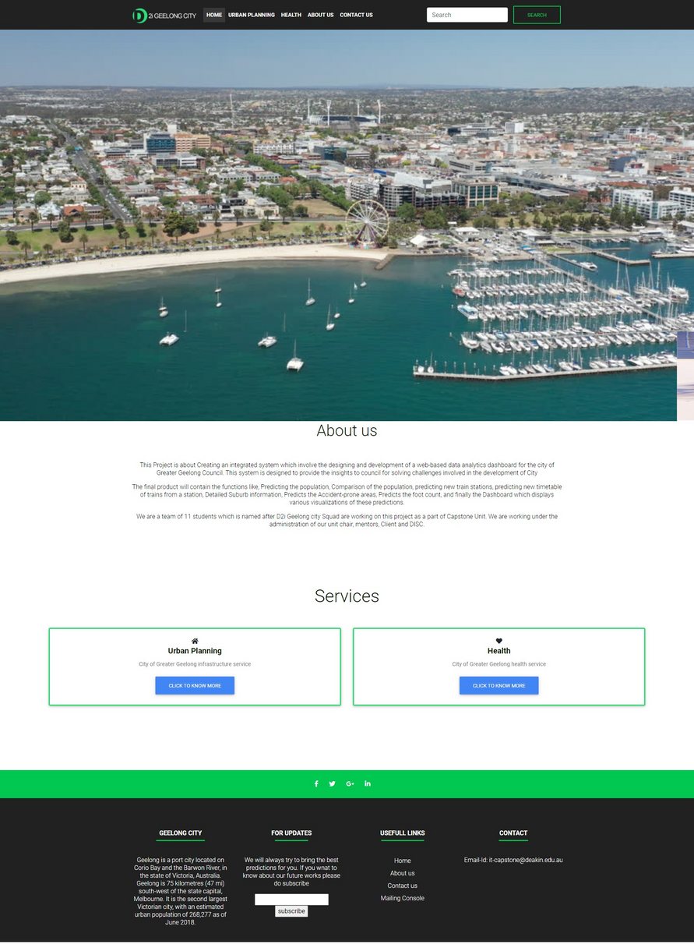
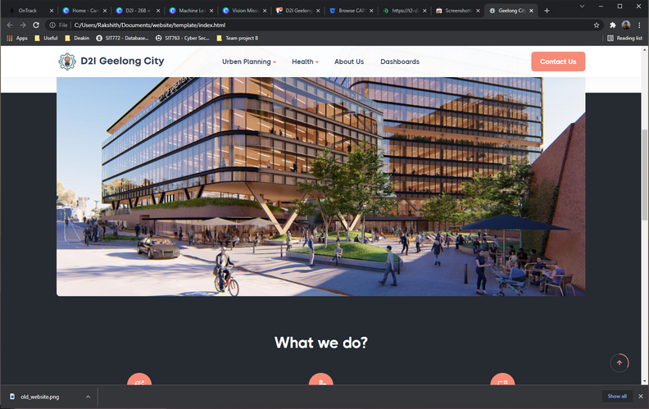

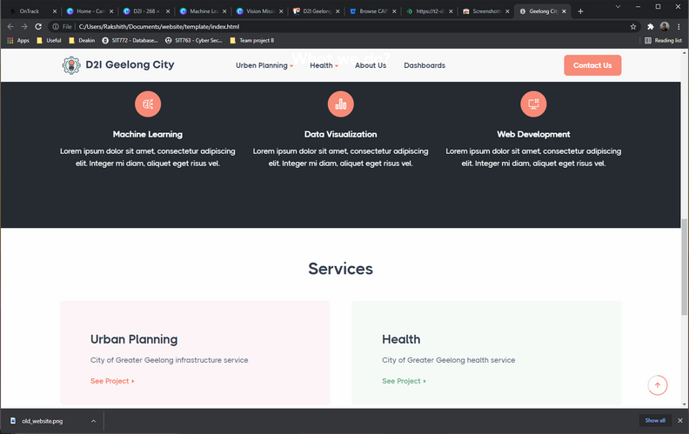
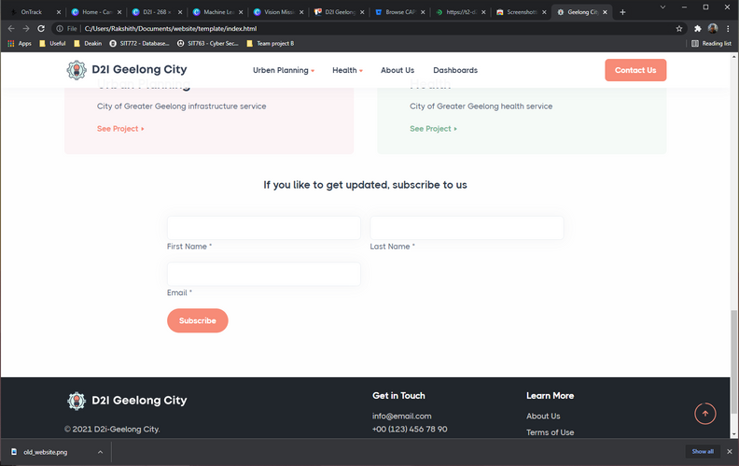
Before
After

Slide 13


Thank you!

